Slide 1
Models Health
Sharon Yanicki, part B
Jan. 14 2016

Slide 2
Review – i-clicker question
The three models of health described by Labonte (1993) include the following except:
Socioenvironmental model
Ecological or Socioecological model
Biomedical model
Behavioural model
a, b and c

Slide 3
Learning Objectives
By the end of this class you will be able to describe:
Three models of health (dominant in health discourse in Canadian society)
Sociological critiques of the models
The key elements of the socioenvironmental model

Slide 4
Dominant Models of Health
  Biomedical Model
    A focus on individual health and the absence of disease
  Behavioural Model
    A focus on individual behaviour and choices
  Socioenvironmental Model
    A focus on the interaction of persons and socioenvironmental contexts

Slide 5
Biomedical Model
Health - absence of disease or infirmity
Illness - loss of health (Nowatzki, 2003)
Disease - diagnosed by a physician using a classification system for defining diseases by type and cause.
Scientific - observable and measurable
- identifying the specific cause of each disease
Focus - treating disease/injury/disability in individuals
- repairing the ‘broken’ parts
- treating germs that have entered the body
Health/illness as a continuum (Labonte, 1993)
Health Illness/Disease

Slide 6
Assumptions – Biomedical Model
Biomedical Model
Mind/body dualism
Physical reductionism
The doctrine of specific etiology
Machine metaphor
(Freund, McGuire, & Podhurst, 2003)
Notes:
physical disease is located sole within the body
illness can be reduced to disordered bodily (biochemical or neurophsyiological) functions
3. each disease is caused by a specific identifiable agent
leads to a quest for the ‘majic bullet’
leads to overreliance on pharmaceuticals
4. the body is a complex biochemical machine, and disease is the malfunctioning of some constituent mechanism.

Slide 7
Critique Biomedical Model
“The dominant model of disease today is biomedical, and it leaves no room within its framework for the social, psychological, and behavioral dimensions of illness.” (Engel, 1977)
Limitations – Biomedical Model
Fallacy of specific etiology
Objectification
Physical Reductionism
Victim-blaming
(Freund, McGuire & Podhurst, 2003, p. 6-7)
Notes:
Doctrine of specific etiology (Dubois, 1959) assumes that each disease is caused by a potentially identifiable agent. This has been both a fruitful and a limiting assumption.
Objectification –the body is the object of regimen and control
Physical (Biochemical or neurophysiologic) Reductionism – Assumes that the body can be treated separately from behaviour, social, psychological, environmental contexts (mind/body dualism)

Slide 8
Behavioural Model
Lalonde (1974) http://www.hc-sc.gc.ca/hcs-sss/alt_formats/hpb-dgps/pdf/pubs/1974-lalonde/lalonde_e.pdf
Health viewed as: “energy, physical-functional ability, physical wellness and appropriate disease-preventing lifestyles” (Lalonde, 1974, cited in Labonte, 1993, p. 33)
Behavioural (Lifestyle) approach to health:
    reduce behavioural (modifiable) risk factors
    promote physical wellbeing
    increase individual healthy choices
    prevent disease
Notes:
Lifestyle, Environment, Human Biology & Health Services

Slide 9
Critique – Behavioural Model
Assumes that:
everyone has equal opportunities for choosing healthy behaviour
  liberal individualism
health behaviour is an individual responsibility.
  victim blaming
However, ideas and health behaviour are socially constructed within society through:
shared ideas within a cultural group or society, and
power relations that are shaped by social structures (Friend, McGuire & Podhurst, 2003).

Slide 10
Socioenvironmental Model
    Socioenvironmental (Labonte, 1993, p. 32)
Health is a positive state involving interaction: individuals, groups, populations and environment (social, economic, cultural and political).
Defined in relation to:
    connection to family/friends/the community
    self-efficacy
    sense of being in control
    Ability to do things that are meaningful/important
    Psychological and social “wellness”

Slide 11
Socioenvironmental Model
Socioenvironmental Model
  Commonly applied in social epidemiology with a focus on (Labonte, 1993):
  population health
  the social determinants of health & illness
  Considers
    The biomedical causes of disease are considered in interaction with:
      physiological and psychosocial causes
      social structures and living conditions
      factors that constrain/enable individual choice

Slide 12
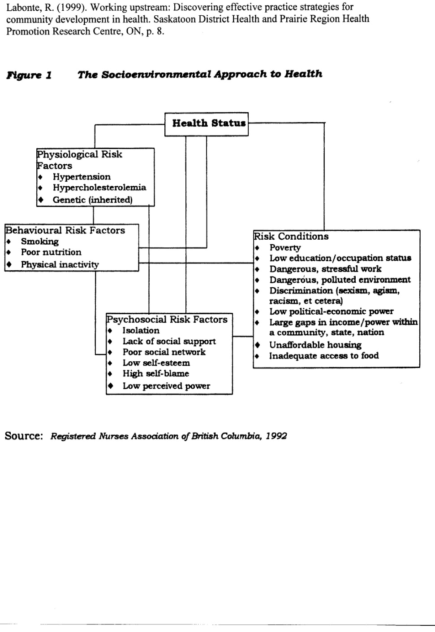

Slide 13
Critique – Socioenvironmental Model
Assumes that disease and illness can be identified through causal pathways and linear relationships that include physiological, behavioural, psychological risk factors and living in risk conditions (social factors).
The impacts of medicalization and power relations on health are not clearly identified.
Limited focus on the intersection of multiple sources of inequality in shaping health and illness within populations.

Slide 14
Discussion
How doe the three models of health differ (Biomedical, Behavioural and Socioenvironmental)?

Slide 15
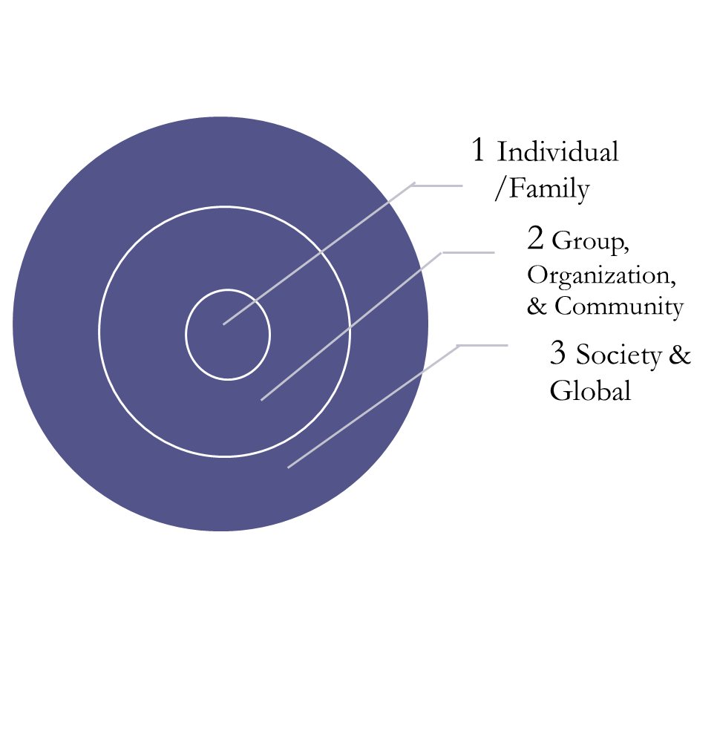
Socioecological Model
Health is a relative concept
Socially constructed
(Segall & Chappell, 2000)
Multiple Sources of Influence

Slide 16
Socioecological Models of Health
Considers multi-causality and reciprocal relationships
Considers multiple points of intervention (intrapersonal, interpersonal, organizational, community, society, and global)
Critical socioecological models consider power relations and multiple sources of inequality (Yanicki, Kushner & Reutter, 2015).
Critique:
The complexity of socioecological may be difficulty to explore through commonly used research methods.

Slide 17

Prerequisites for Health: Ottawa Charter (WHO,1986)
Peace
Shelter
Education
Food
Income
A Stable Ecosystem
Sustainable Resources
Social Justice
Equity

Slide 18
Good Health as Balance
A Positive Definition of Health - Saskatchewan Provincial Health Council (1994)
“a dynamic process involving the harmony of physical, mental, emotional, social and spiritual well-being.
Health enables individuals, families and communities to function to the best of their ability within their environment “ (cited in Labonte, 1999, p. 6).

Slide 19
Social Model of Health
Ottawa Charter for Health Promotion (WHO, 1986)
– a social model of health
Multiple prerequisites
Multiple dimensions
A product of social and environmental interaction
Subject to change
Equity, empowerment, social justice and sustainable environments matter for the health of populations
Notes:
How we conceptualize health affects the ways in which we try to interview to promote health.

Slide 20
Normal Health Vs Perfect Health
Assumptions of ‘Normality’
    Is it normal to be healthy?
    Can the experience of illness be a part of ‘normal’ health?
  ‘Perfect’ health = ideal and goal
Health is viewed in comparison to the norm, to others, based on gender, and to our past health.
(Segall and Chappell, p. 44)

Slide 21
Discussion
From a Structural/Functional view of health consider the following :
How would you define health?
Is it normal to be healthy?
Is it normal to experience illness?

Slide 22
Health Status Designation
Twaddle’s (1974) Process of Health Status Designation:
  Judgements - levels of functioning
  Evaluation (e.g. self versus other)
  Frame of reference (selection of issues re: good health or ill health)
  Awareness Disclosure
Defining Illness Change in Roles
(cited in Segall & Chappell, 2000)

Slide 23
I-Clicker Question
Critiques of the biomedical model include the following except:
a) medicalization and power relations on health
b) fallacy of specific etiology
c) objectification
d) physical reductionism
e) victim-blaming

Slide 24
References
Bezrucha, S. (2010). Epidemiological approaches to population health. In T. Bryant, D. Raphael, & M. Rioux. Staying Alive: Critical perspectives on health, illness and health care. (2nd ed., pp. 13-40) Toronto: Canadian Scholar’s Press Inc.
Bourgeault, L. (2010). Sociological perspectives on health and health care. In T. Bryant, D. Raphael, and M. Rioux. Staying Alive: Critical perspectives on health, illness and health care. (2nd ed., pp. 41-63) Toronto: Canadian Scholar’s Press Inc.
Engel, (1977) The need for a new medical model: a challenge for biomedicine, Science, (196) 4286, 129 – 136.
Freund, P.E.S., McGuire, M.B., Podhurst, L.S. (2003). Health, illness and the social body: A critical sociology. New Jersey: Upper Saddle River, p. 4-6.
Labonte, R. (1993). Health promotion and empowerment: Practice frameworks, Toronto: Centre fore Health Promotion & ParticipACTION. p. 16-22

Slide 25
References
.
Labonte, R. (1999). Working upstream: Discovering effective practice strategies for community development in health. Saskatoon, Sask.: Saskatoon District Health & Prairie Region Health Promotion Research Centre. p. 5-9.
Lalonde, M. (1974). A new perspective on the health of Canadians. Health & Welfare Canada. Accessed 16/09/2010 from: http://www.phac-aspc.gc.ca/ph-sp/pdf/perspect-eng.pdf
Nowatzki, N. (2003, 2004). Sociology of Health and Wellness Sociology 2850: Lecture Notes., University of Lethbridge.
Segall, A., Chappell, N.L. (2000). Health and health care in Canada. Toronto: Prentice Hall. (p. 21-51).
World Health Organization (1986). Ottawa Charter for Health Promotion. Accessed 16/09/2010 from: http://www.who.int/hpr/NPH/docs/ottawa_charter_hp.pdf
Yanicki, S. M., Kushner, K. E., & Reutter, L. (2015). Social Inclusion/Exclusion as matters of social (in)justice: A call for nursing action. Nursing Inquiry, 22(2), 121-133. doi:10.1111/nin.12076

